Slide 1



COP290 PROJECT
Vidya Charan
and
Aditya Vaddi

Slide 2
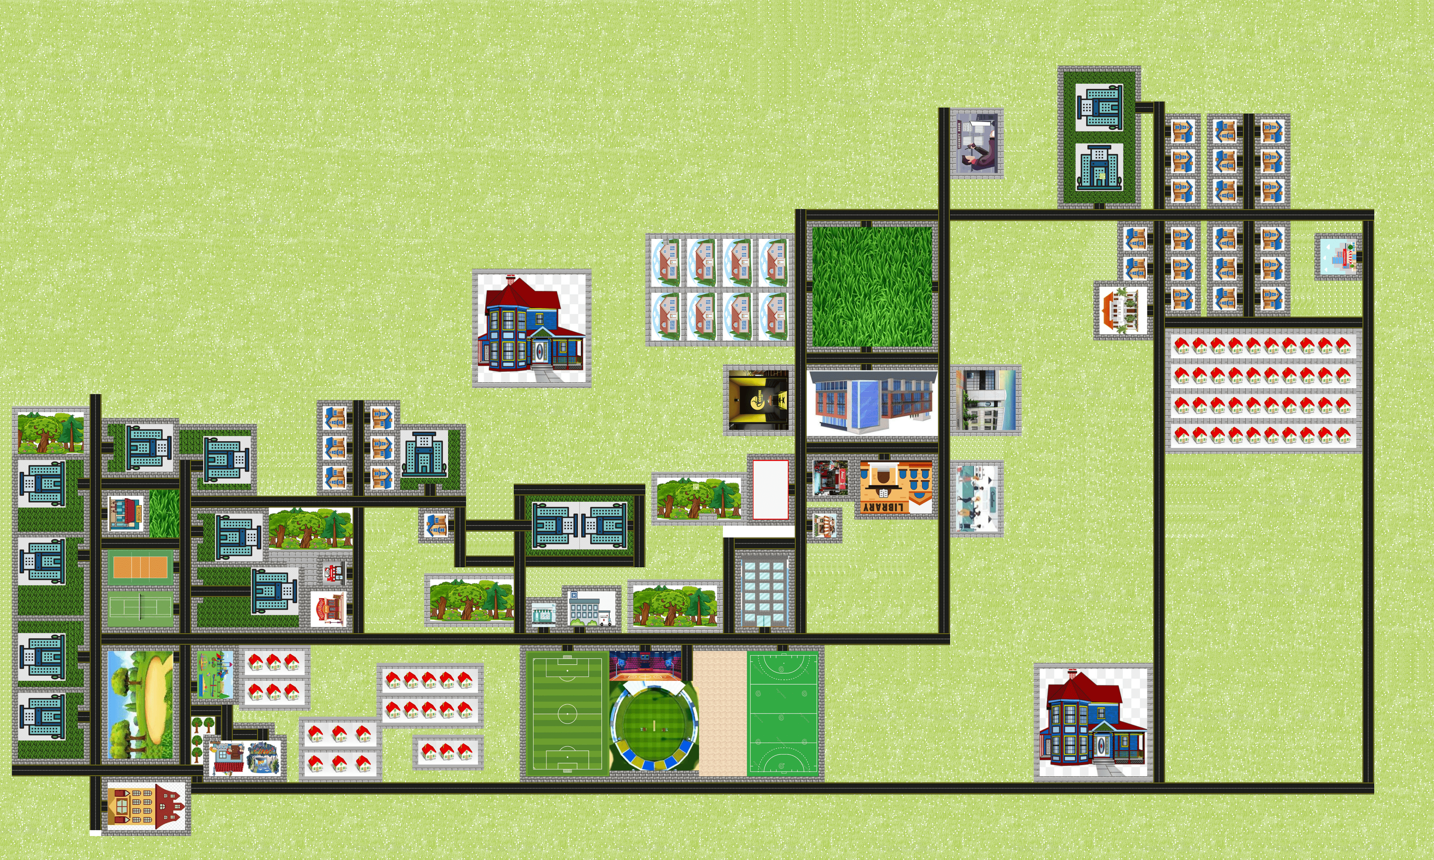
IIT DELHI MAP FOR GAME

Slide 3
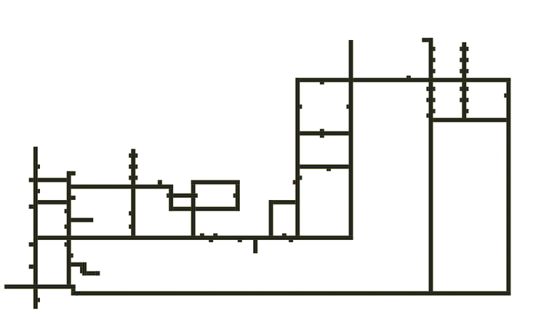
This is the area in which only the boy or girl can move. They can move only on these roads.

Slide 4
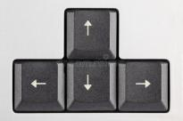




These keys are used to make the player move left, up, down and right directions.
When this up arrow key is pressed, the player moves up.
When this down arrow key is pressed, the player moves down.
When this left arrow key is pressed, the player moves to the left.
When this right arrow key is pressed, the player moves to the right.

Slide 5
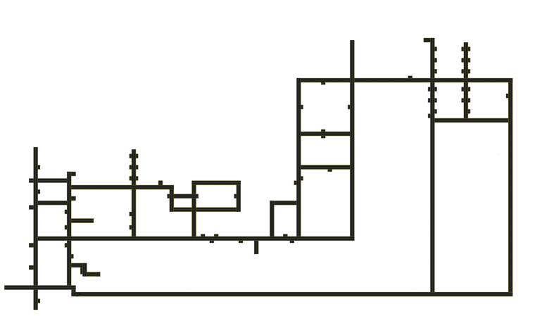
In the two green colour roads, the player’s speed will be five times that of his normal speed. That is, if the player comes to this road, the speed will be increased to five times.
And also, in the vertical road if we press keys U/D, it will move up/down faster.
In the same way, in the horizontal road, if we press L/R keys, it will move left/right faster.

Slide 6
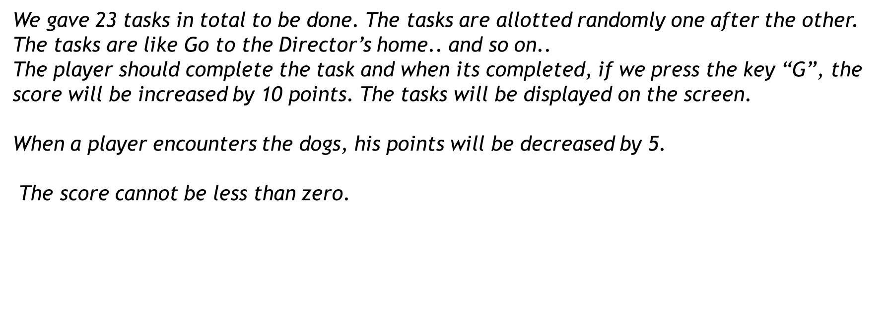
Instructions
When we press key “M”, then the music will start. In order to stop the music too, you need to press the same key “M”.

Slide 7
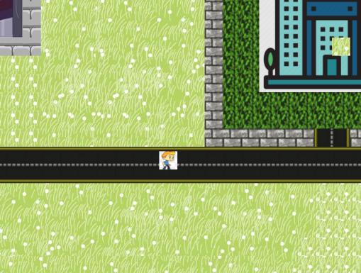
When the player is standing still, this is the screenshot of him.

Slide 8
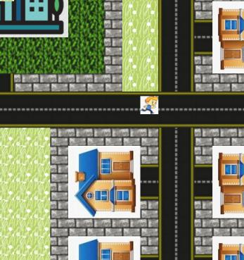
When the player is running right, he is appeared in this manner.

Slide 9
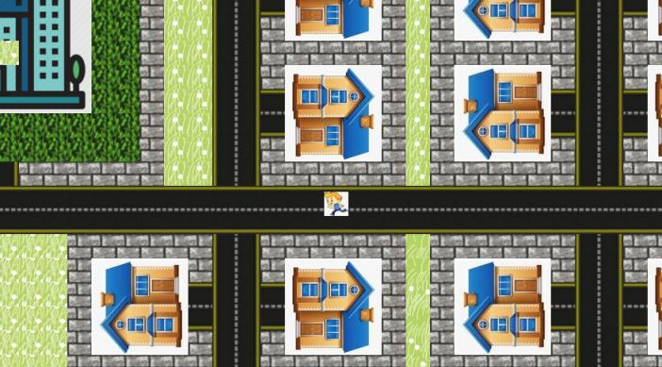
If the man is running left, he is appeared in this manner.

Slide 10
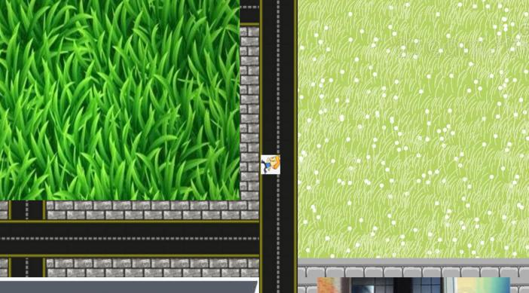
If the man is running down, he is appeared in this manner.

Slide 11
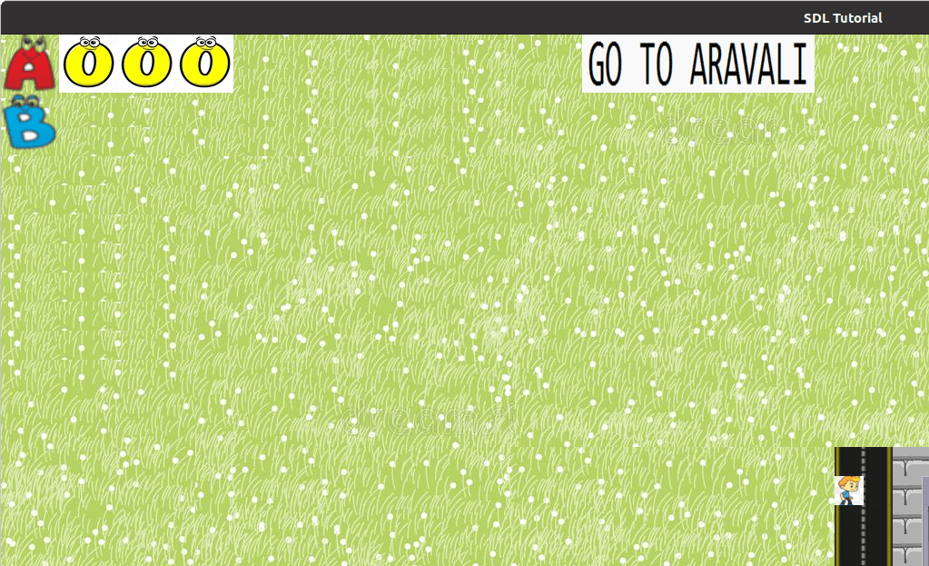
This is the task given to the person.
This is the score board.

Slide 12
Thank you
Prof. Rijurekha mam……

